Slide 1


Gopi Krishna Seerapu
01/12/2024

Slide 2

Outline
Executive Summary
Introduction
Methodology
Results
Conclusion
Appendix

Slide 3
Executive Summary
• Summary of methodologies
○ Collecting Data through:
■ API call to Space X Data
■ Web Scraping (beautiful soup)
○ Data Wrangling/Organization
○ Exploratory Data Analysis using:
■ SQL
■ Data Visualization
○ Interactive Visual Analytics using folium
○ Machine Learning Predictions on Associated Dataframes.
• Summary of all results
○ Exploratory Data Analysis Results
○ Interactive Analytics in Jupyter Notebooks
○ Predictive Analytics result from ML

Slide 4
Introduction
Project Overview and Significance
The primary goal of this capstone project is to forecast the successful recovery of Falcon 9's first stage. SpaceX has gained attention for its Falcon 9 rocket launches, offering them at a cost of 62 million dollars, significantly less than the 165 million dollars charged by other providers. This cost efficiency is largely due to SpaceX's revolutionary practice of reusing the rocket's first stage. Therefore, accurately predicting the likelihood of a successful first stage landing is key to evaluating the total cost of a launch.
Research Questions
What variables are crucial in determining the success of a rocket's landing?
Which conditions are essential for the success of a rocket landing program?
Can these elements be utilized to both assess past trends and forecast future landing outcomes?

Slide 5

Section 1

Slide 6
Methodology
Executive Summary
Data collection methodology:
The information was gathered through a combination of utilizing the SpaceX API and extracting data from Wikipedia's pages via web scraping.
Perform data wrangling
One-hot encoding was used on categorical attributes.
Perform exploratory data analysis (EDA) using visualization and SQL
Perform interactive visual analytics using Folium and Plotly Dash
Perform predictive analysis using classification models

Slide 7
Data Collection
The data was collected using the following:
We gathered data by sending GET requests to the SpaceX API.
The response was then converted into JSON format using the .json() method, and subsequently transformed into a pandas dataframe with the help of .json_normalize().
Following this, we undertook data cleansing, including identifying and addressing missing values either by substituting them with averages or marking them as 'N/A'.
Additionally, we extracted data about Falcon 9 launch records from Wikipedia using web scraping techniques. This involved retrieving data from HTML tables using BeautifulSoup, parsing these tables, and then converting the information into a pandas dataframe format.

Slide 8
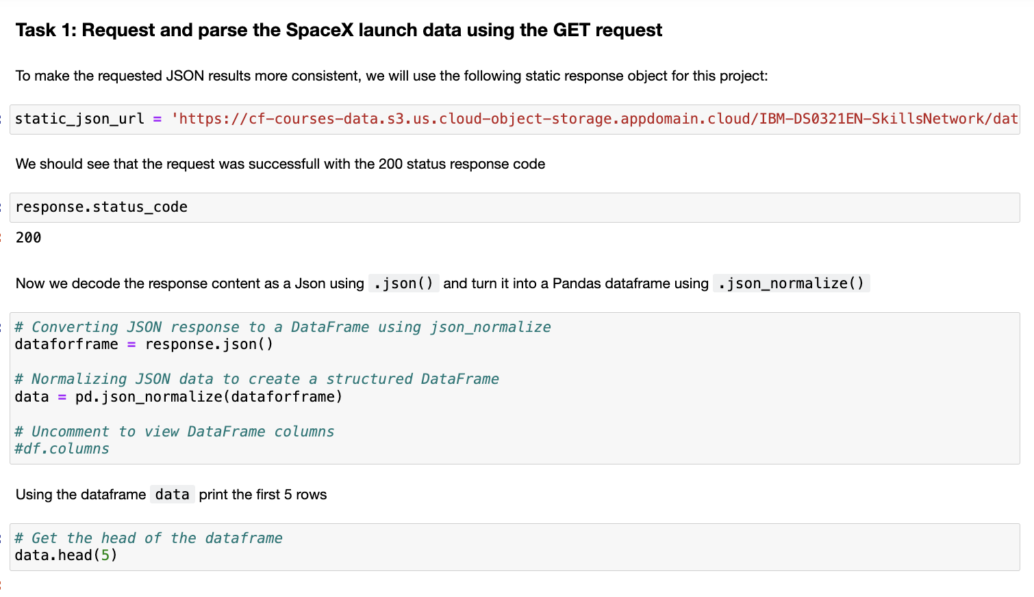
Data Collection – SpaceX API
I employed a straightforward GET request and checked the response status code. Additionally, I performed data normalization to achieve a more refined dataframe.
GitHub URL - https://github.com/swethakandala/IBM-Data-Science-Capstone/blob/main/Week_1_LAB1_spacex_Data%20Collection-API.ipynb

Slide 9
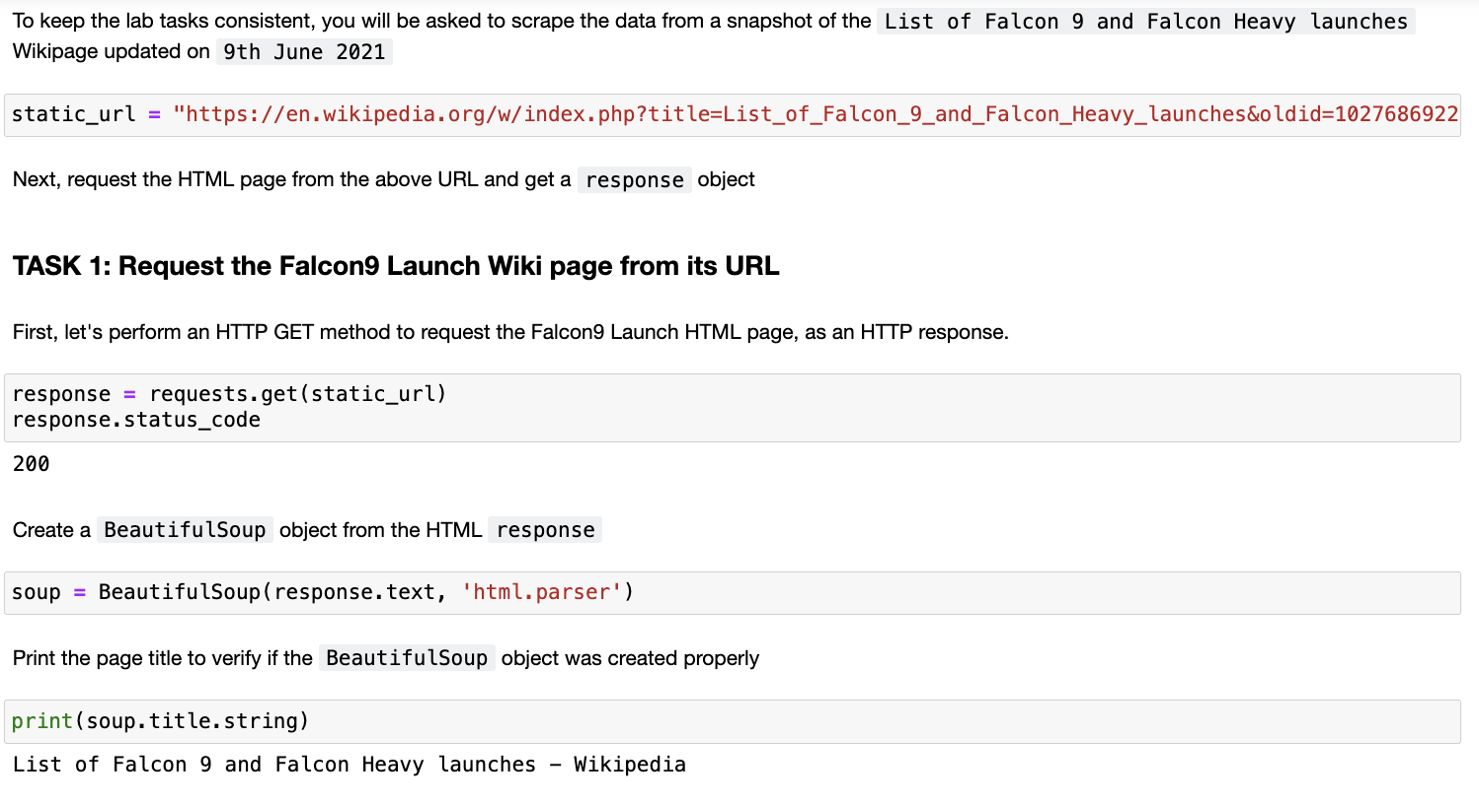
Data Collection - Scraping
Utilized the Falcon9 Launch Wikipedia page, extracting all header names from its HTML table. Subsequently, a dataframe was constructed by parsing these launch tables.
GitHub URL - https://github.com/swethakandala/IBM-Data-Science-Capstone/blob/main/Week_1_spacex_Data%20Collection_Web_Scrapping.ipynb

Slide 10
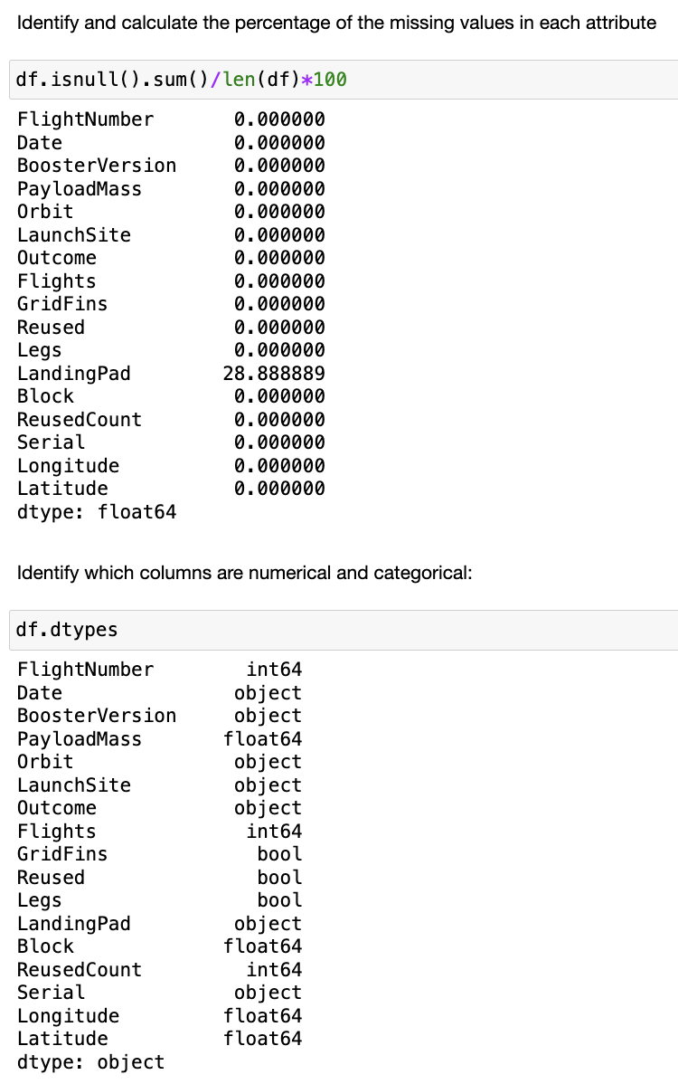
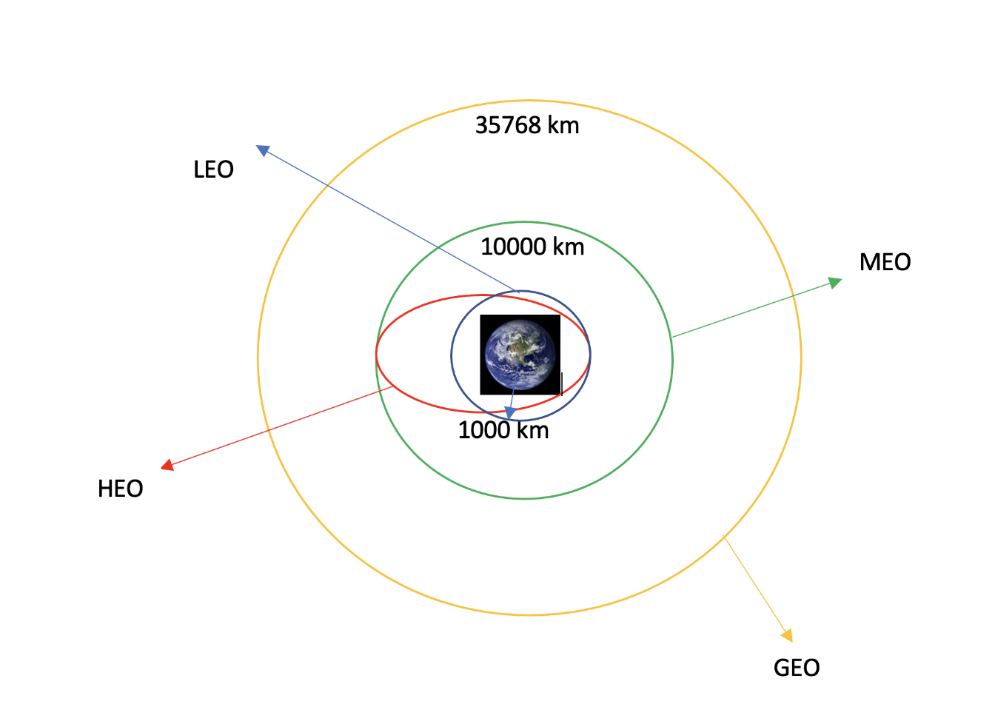
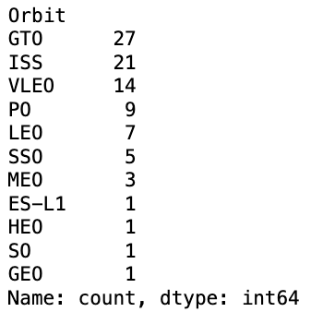
Data Wrangling
We analyzed various instances where rocket boosters failed to land properly, transforming these instances into a new column of binary data. We verified the accuracy of the data transmission by examining its type. Additionally, we identified and quantified any missing data in our collection, filling in gaps with average values.
This process was conducted alongside an evaluation of the frequency of orbits, utilizing this information to assess the success rates of specific landings.
GitHub URL - https://github.com/swethakandala/IBM-Data-Science-Capstone/blob/main/Week_1_LAB2_spacex_Data_Wrangling.ipynb

Slide 11
EDA with Data Visualization
Created scatter and bubble plots using Seaborn to showcase the correlation between flight number and launch site, payload mass and launch site, as well as the distribution of orbit success based on flight numbers. Also developed plots depicting the relationship between payload mass and orbit classifications.
Developed a Seaborn bar chart to depict the success rates associated with different types of orbits.
Constructed a Seaborn line graph to illustrate the trend of success rates over various years.
Implemented the creation of dummy variables and converted numerical columns to float64 for the purpose of feature engineering.
GitHUB URL- https://github.com/swethakandala/IBM-Data-Science-Capstone/blob/main/Week_2_spacex_Dataviz.ipynb

Slide 12
EDA with SQL
Employed Postgresql to isolate distinct records of landing sites through SQL queries.
Calculated and presented average payload data, both overall and separated by different booster models.
Developed queries to showcase singular instances, including the dates of successful landings and the identification of boosters involved in these successful missions, along with their frequency.
GitHUB URL - https://github.com/swethakandala/IBM-Data-Science-Capstone/blob/main/Week_2_EDA_SQL.ipynb

Slide 13
Build an Interactive Map with Folium
Plotted all launch locations on a Folium map using blue circular markers.
Converted landing results into binary values (true/false) for feature representation.
Created color-coded clusters for easier identification.
Calculated the distances from different launch sites to nearby railways, highways, and coastlines.
Summarized the various map elements like markers, circles, and lines that were incorporated into the Folium map.
GitHUB URL - https://github.com/swethakandala/IBM-Data-Science-Capstone/blob/main/Week_3_spacex_Launch_site_location.jupyterlite.ipynb

Slide 14
Build a Dashboard with Plotly Dash
Displayed all rocket launch locations on a folium map with blue circles
Dashboard characteristics include time customization options:
Displayed pie charts showing the number of launches from specific sites.
Presented scatter plots illustrating the relationship between launch outcomes and payload weights.
Aimed to enable users to analyze and compare the number of launches against their payload mass, highlighting patterns and results in outcomes.
GitHUB URL - https://github.com/swethakandala/IBM-Data-Science-Capstone/blob/main/Week_3_spacex_Dash.py

Slide 15
Predictive Analysis (Classification)
The goal was to conduct Exploratory Data Analysis (EDA) to identify the appropriate Training Labels:
Developed columns representing various classes.
Implemented standardization of the dataset.
Divided the dataset into training and testing subsets.
Employed various machine learning models and optimized their hyperparameters using GridSearchCV.
Adjusted both features (through feature engineering) and algorithms to evaluate and compare the accuracy of different machine learning models in a laboratory setting.
The findings indicated that a classification model was necessary for our problem.
GitHUB URL - https://github.com/swethakandala/IBM-Data-Science-Capstone/blob/main/Week_4_SpaceX_Machine_Learning_Prediction.ipynb

Slide 16
Results
Exploratory data analysis results
Interactive analytics demo in screenshots
Predictive analysis results

Slide 17

Section 2

Slide 18
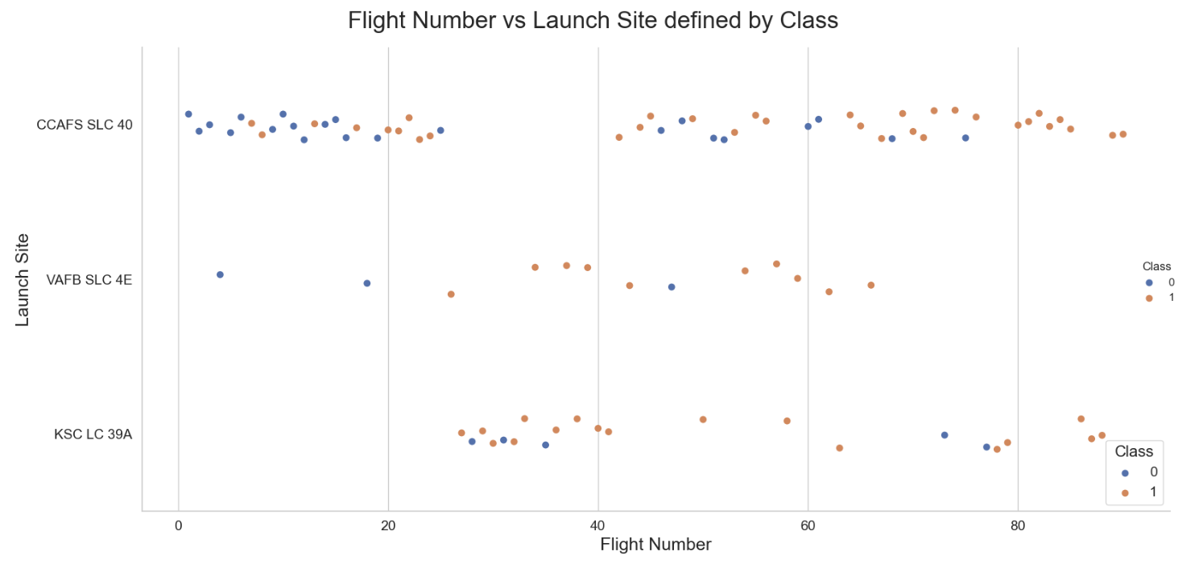
Flight Number vs. Launch Site
This research shows that a higher rate of success is achieved when a greater number of flights are launched from the same site.

Slide 19
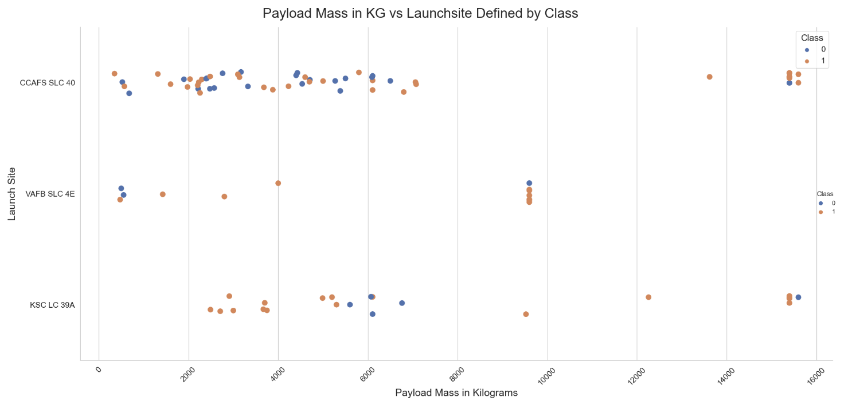
Payload vs. Launch Site
The larger the mass of the payload, the higher the likelihood of success, even when considering extreme values.

Slide 20
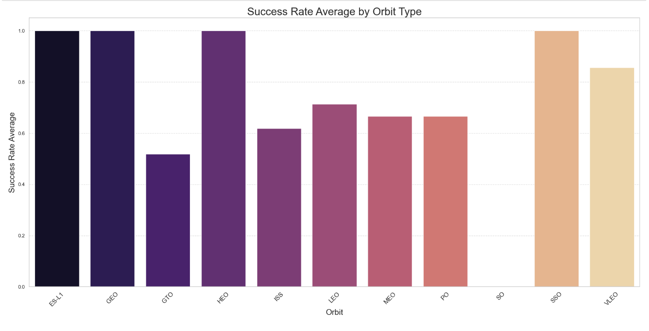
Success Rate vs. Orbit Type
Most successful orbits were:
○ ES-L1
○ GEO
○ HEO
○ SSO
○ VLEO

Slide 21
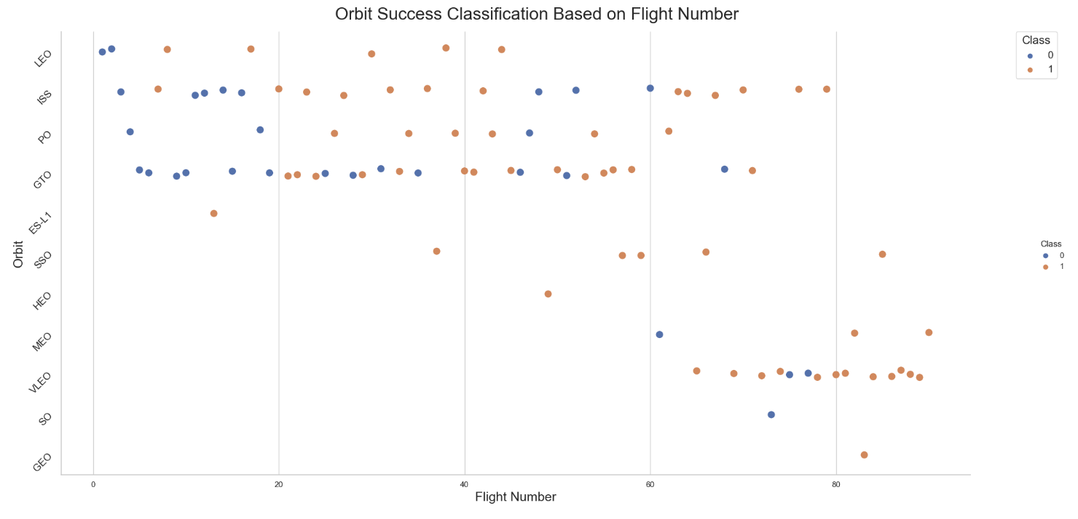
Flight Number vs. Orbit Type
In the context of the Geostationary Transfer Orbit (GTO), there is no correlation between the number of flights and the orbit itself. Conversely, in general scenarios, success is often linked to the frequency of flights.

Slide 22
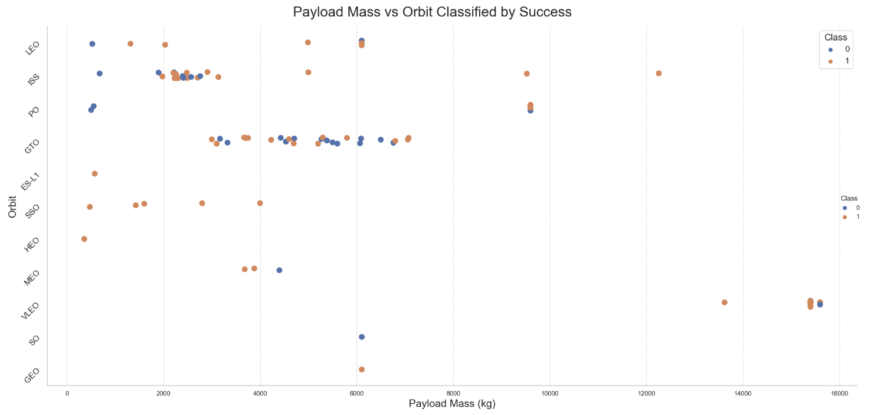
Payload vs. Orbit Type
Heavy payloads are often successfully delivered to Low Earth Orbit (LEO), Polar Orbit (PO), and the International Space Station (ISS).

Slide 23
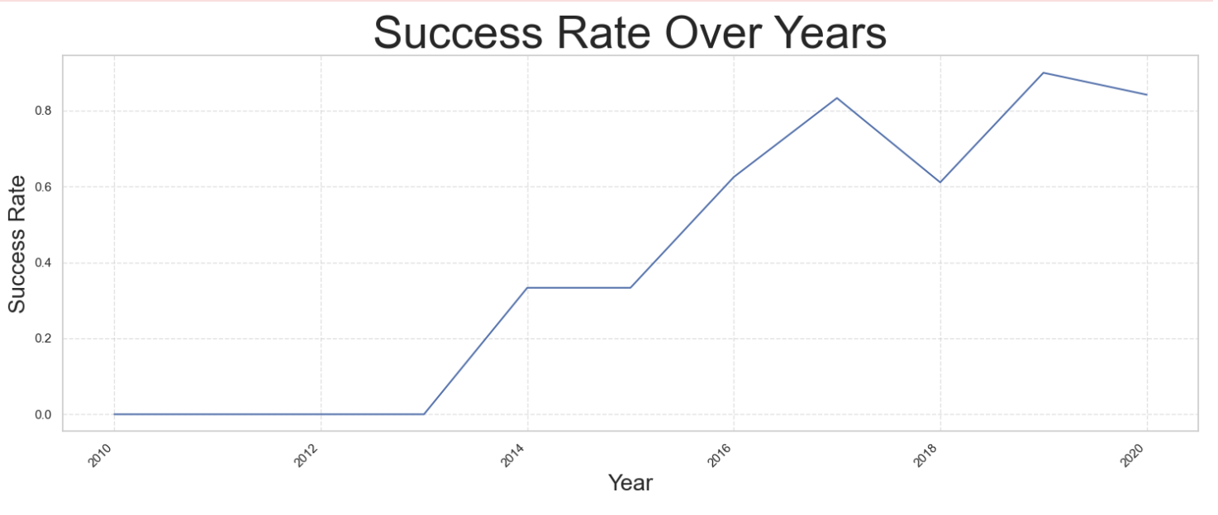
Launch Success Yearly Trend
Since 2013, the success rate has generally been on the rise, although there was a minor decline in 2018, continuing its upward trend until 2020

Slide 24
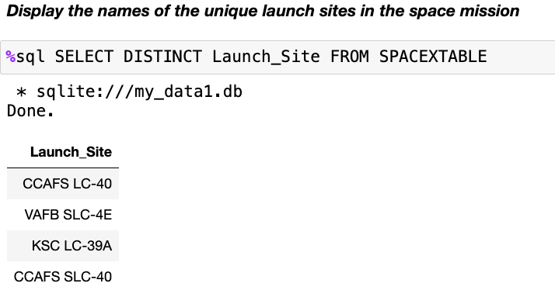
All Launch Site Names
We utilized the term 'DISTINCT' to exclusively display unique launch locations from the SpaceX dataset.

Slide 25
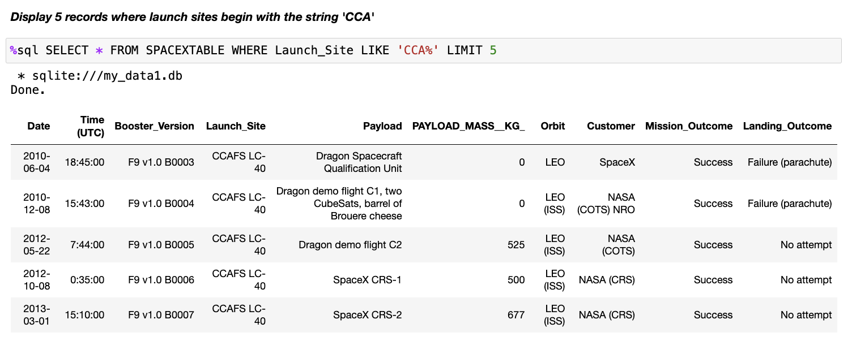
Launch Site Names Begin with 'CCA'
Employed a straightforward search method using a specific term to exhibit the top five entries that correspond with the given term.

Slide 26
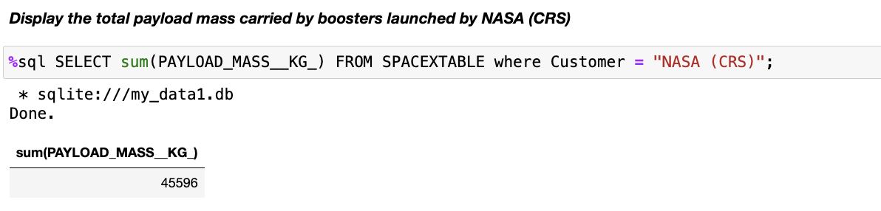
Total Payload Mass
Determined the total cargo weight transported by NASA's rockets using the LIKE keyword in a query.

Slide 27
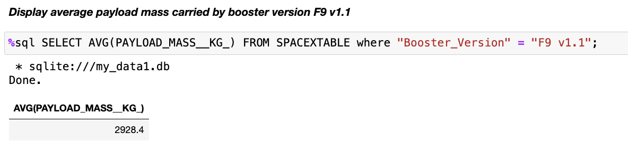
Average Payload Mass by F9 v1.1
Used the avg method in sql to present the following result:

Slide 28
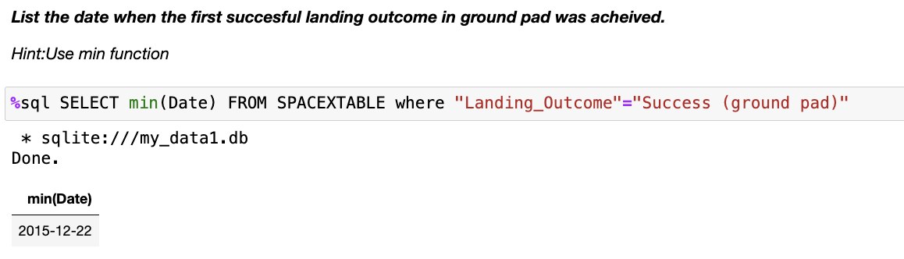
First Successful Ground Landing Date
Use the Min() method in SQL to display the first Successful ground landing date from the edited dataframe:

Slide 29
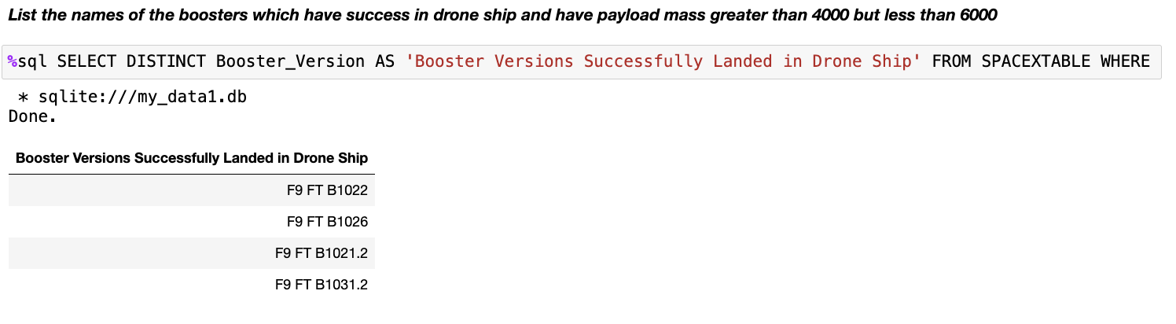
Successful Drone Ship Landing with Payload between 4000 and 6000
Uses DISTINCT and WHERE keywords along with a subquery to determine success between certain payload sizes:

Slide 30
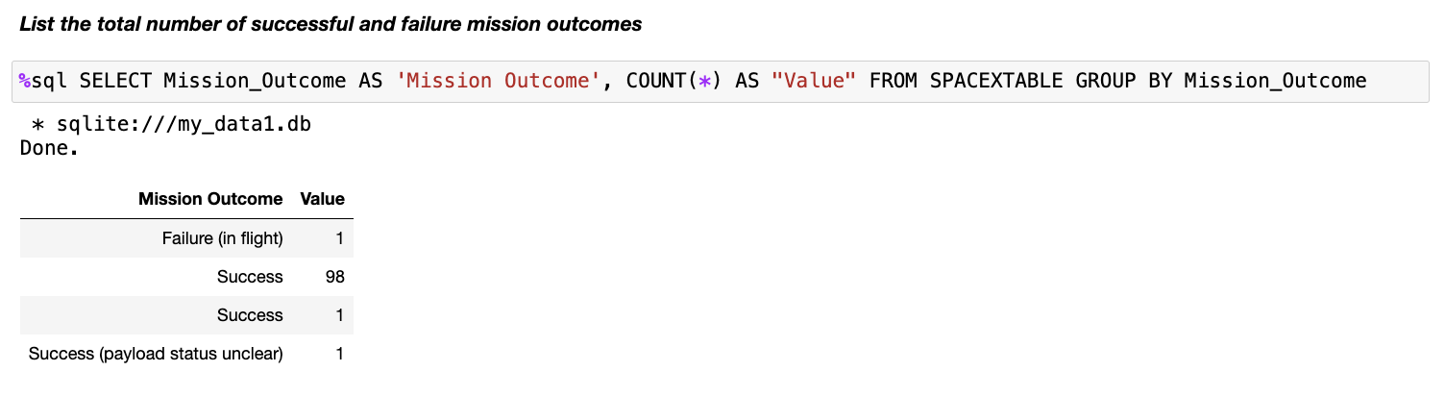
Total Number of Successful and Failure Mission Outcomes

Slide 31
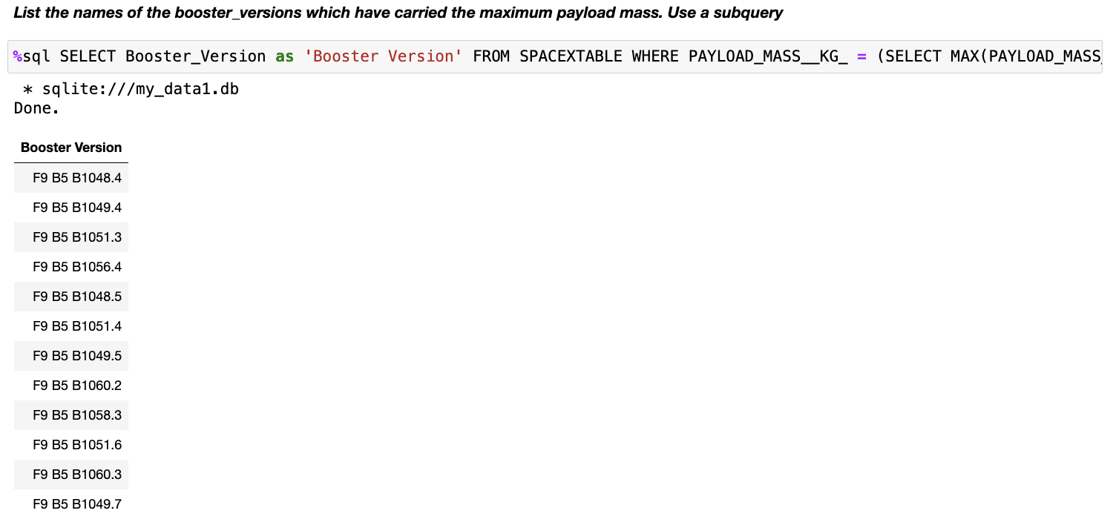
Boosters Carried Maximum Payload
Used wildcard ‘%’ filtering WHERE keyword on success or failure:

Slide 32
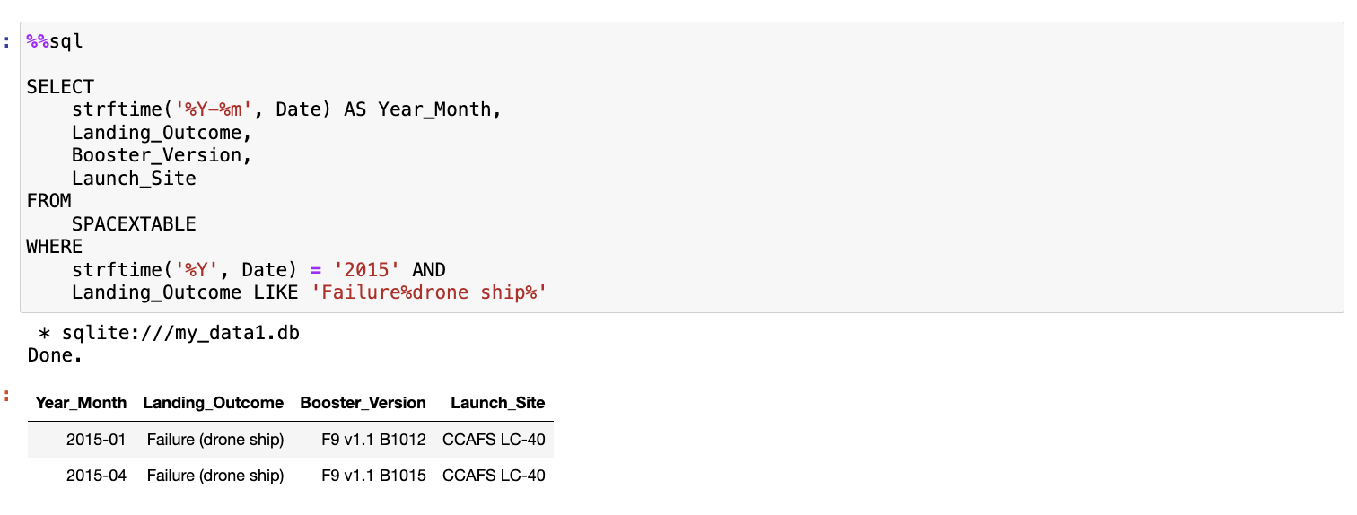
2015 Launch Records
To categorize items using SQL, a substring containing updated dates was created. This approach is employed to ascertain the maximum payload by utilizing a subquery along with the WHERE clause and MAX function.

Slide 33
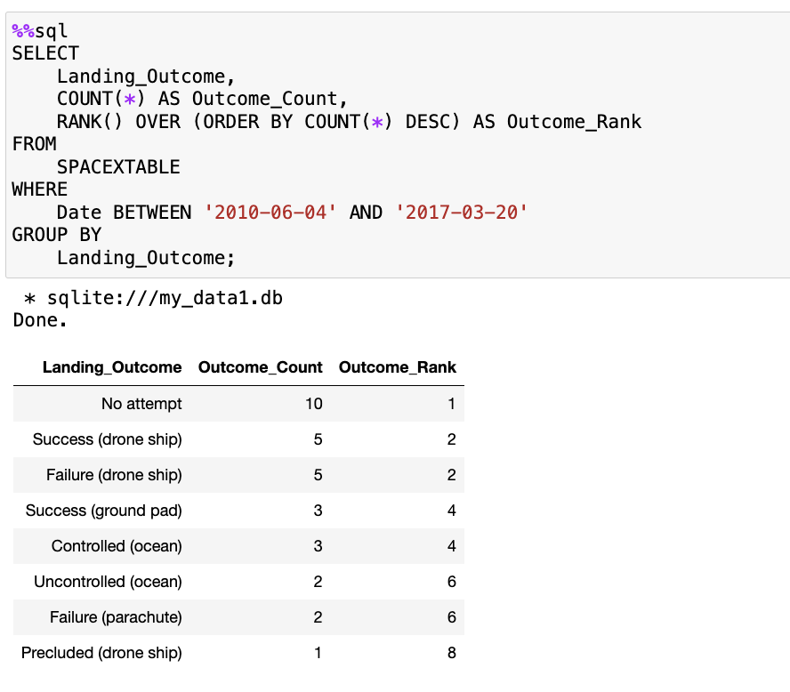
Rank Landing Outcomes Between 2010-06-04 and 2017-03-20
Using COUNT, RANK() with and ORDER BY COUNT subquery: managed to rank outcomes:

Slide 34

Section 3

Slide 35
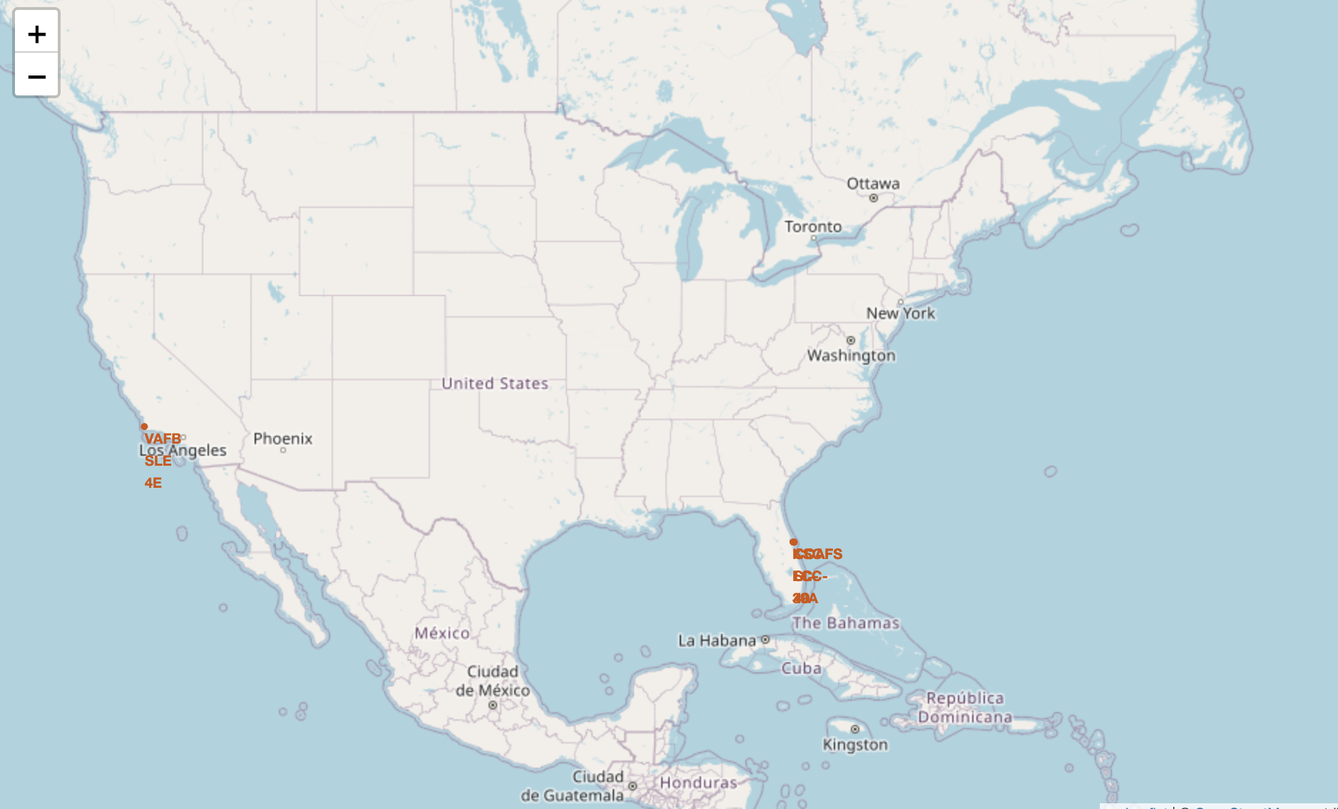
All National Map Markers
The statement is referring to a display or a marker that indicates the locations of space stations in California (CA) and Florida (FL).

Slide 36
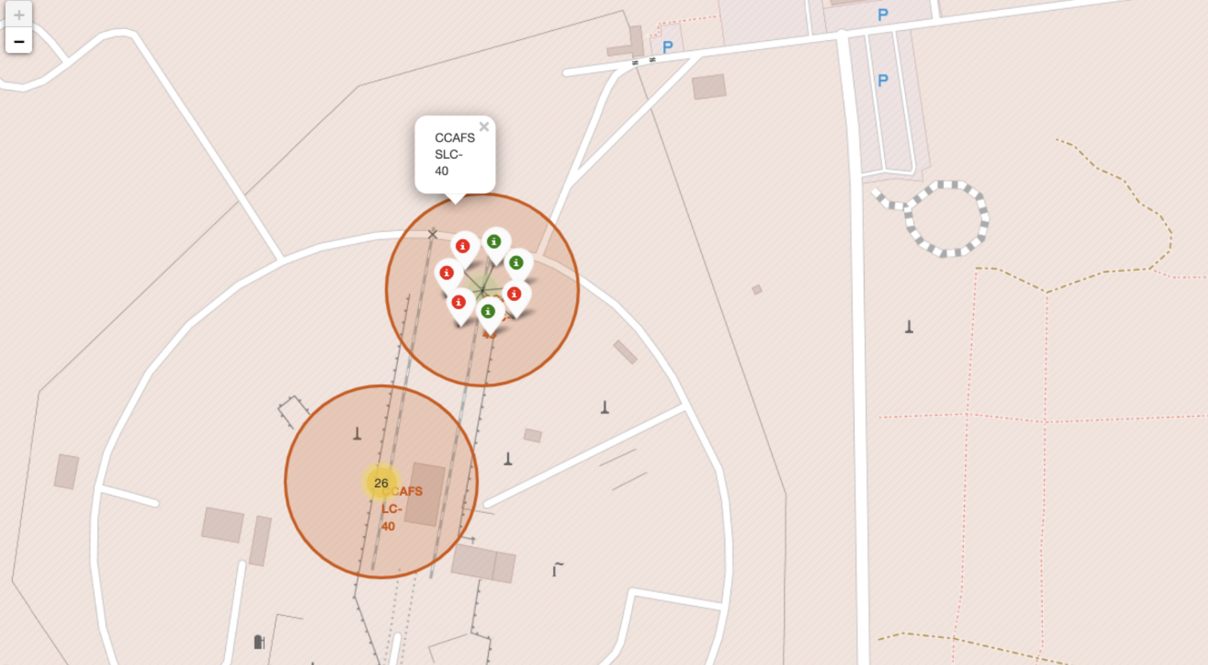
Colored Markers Indicating Rocket Launch Locations
Green markers indicate successful launches, while red markers represent launch failures.

Slide 37

Distance of Launch Site from Nearby Landmarks
Provided an illustration of lines indicating the distances along the coastline, landmarks, and highways as seen in a laboratory setting.

Slide 38

Section 4

Slide 39
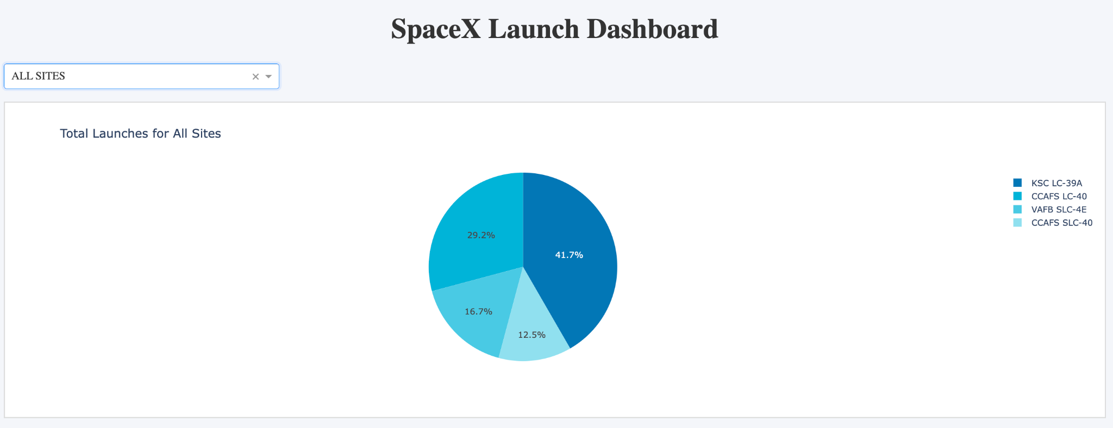
Pie Chart Illustrating the Percentage of Successful Launches
The pie chart shows the distribution of total rocket launches from four sites, with KSC LC-39A accounting for the highest percentage at 41.7%, followed by CCAFS LC-40 at 29.2%, VAFB SLC-4E at 16.7%, and CCAFS SLC-40 at 12.5%.

Slide 40
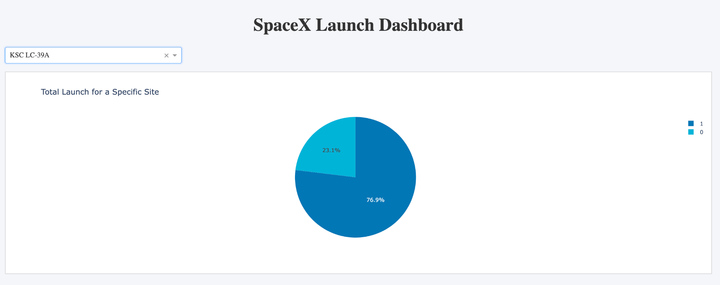
Most Successful Rocket Launch Facility
The pie chart shows the proportion of successful (76.9%) to unsuccessful (23.1%) space launches at a specific site, which is labeled KSC LC-39A.

Slide 41
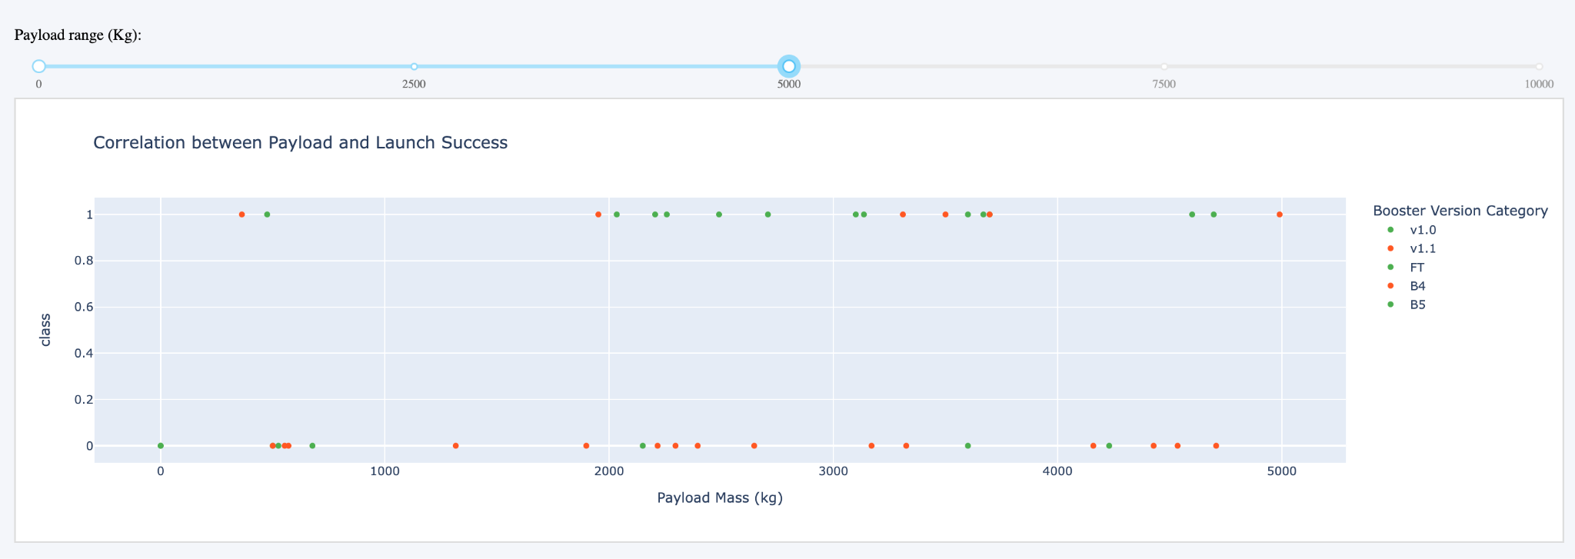
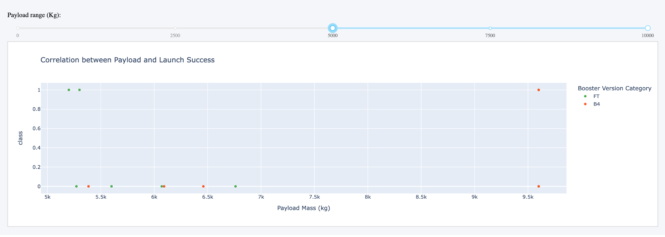
Range of Outcomes for All Launches Illustrated with a Slider
The plots show a mixed correlation between payload mass and launch success across various booster versions, with the second plot indicating higher success for heavier payloads within a specific range.

Slide 42

Section 5

Slide 43
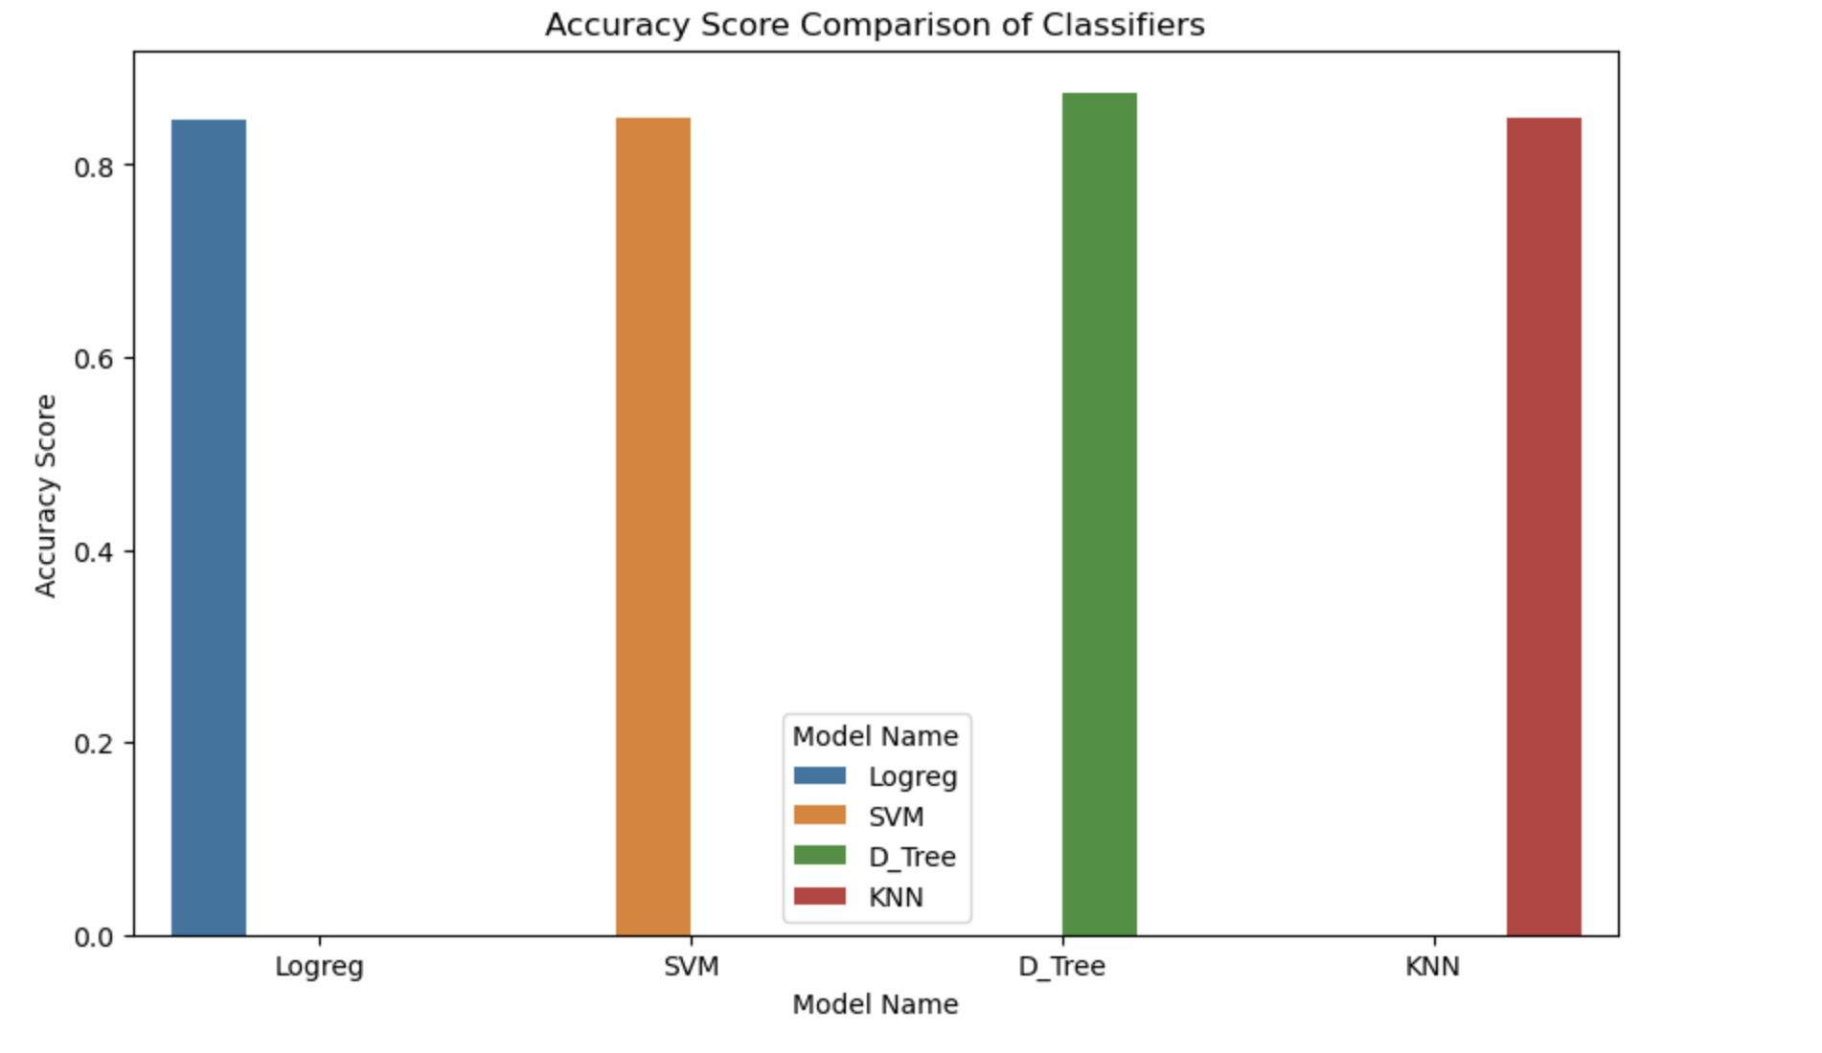
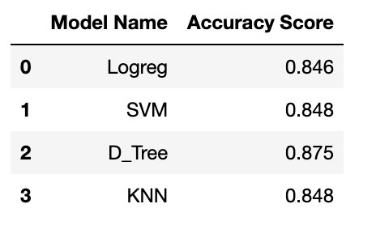
Classification Accuracy
Based on the accuracy score presented in the results, the Decision Tree (D_Tree) model has the highest score at 0.875, making it the best performing model among those listed.

Slide 44
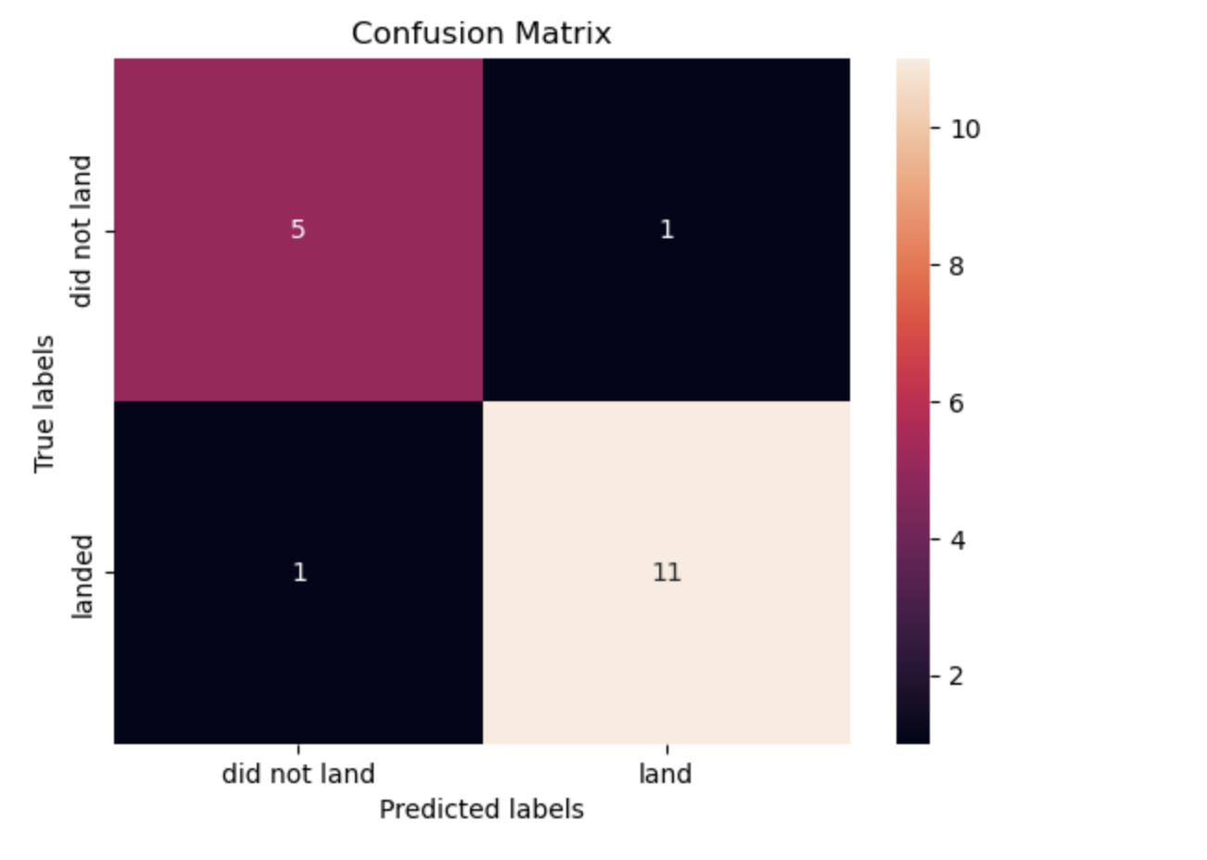
Confusion Matrix
True Positives (TP): 11 instances were correctly predicted as 'land'.
True Negatives (TN): 5 instances were correctly predicted as 'did not land'.
False Positives (FP): 1 instance was incorrectly predicted as 'land' when it did not.
False Negatives (FN): 1 instance was incorrectly predicted as 'did not land' when it did.
This matrix is a visual representation of the decision tree model's performance, with the main diagonal (top-left to bottom-right) showing correct predictions. The model seems to be relatively well-balanced in terms of precision and recall, given the low number of false predictions (FP and FN).

Slide 45
Conclusions
Increasing the number of flights from the same location enhances the likelihood of successful landings, thanks to ongoing improvements.
The success rate of launches has been consistently high and has risen between 2013 and 2020.
The Kennedy Space Center's LC-39A site witnessed the highest number of successful launches.
About five out of nine orbits (namely ES-L1, GEO, HEO, SSO, VLEO) experienced similarly high success rates.
The Decision Tree Classifier emerged as the most effective machine learning model for predicting outcomes. This is due to the majority of our data and predictions being binary in nature, focusing on whether a launch was successful.

Slide 46
Appendix
Repository link - https://github.com/gopi245/IBM-Data-Science-Capstone/upload/main

Slide 47


